Slide 1
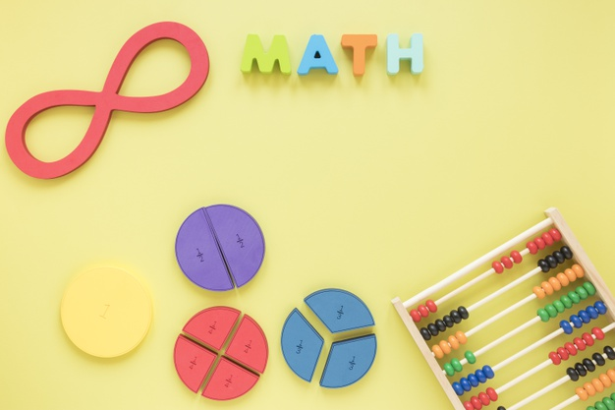
Equivalent fractions

Slide 2

Equivalent fractions
The word equivalent means equal or the same. So, equivalent fractions are fractions that have the same value, but they are written differently.

Slide 3
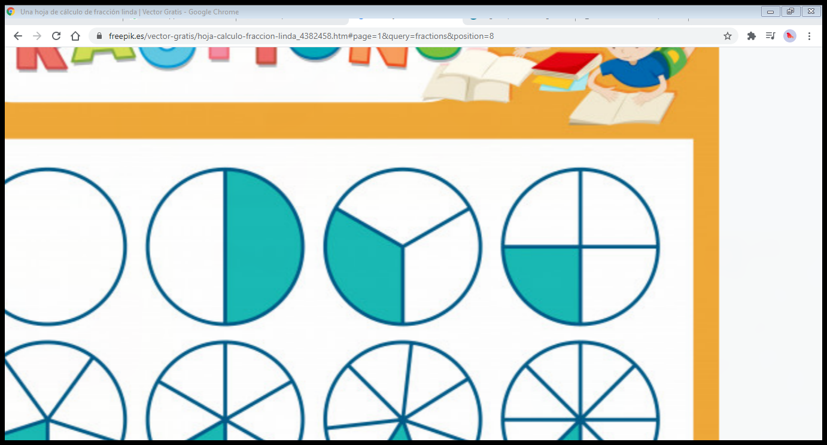
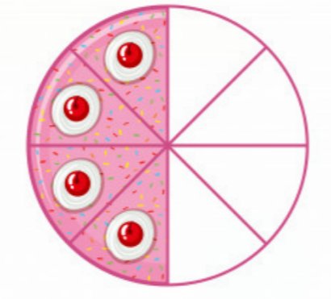

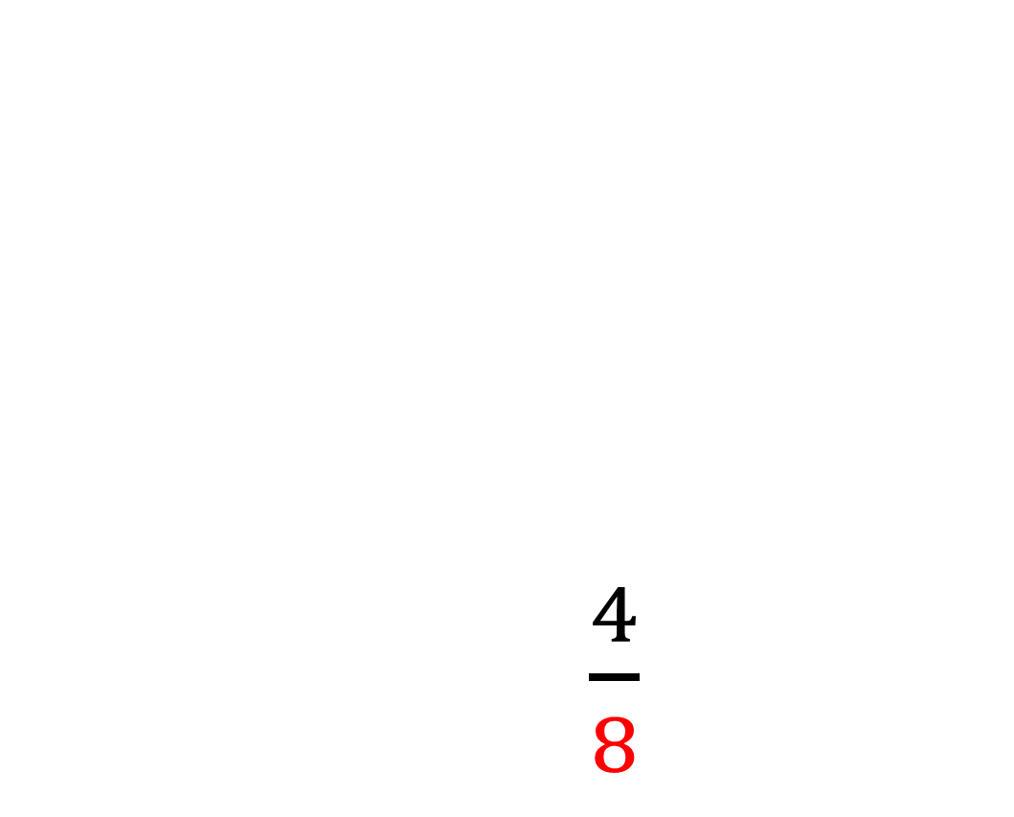
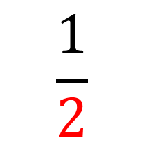
Equivalent fractions
The denominator shows the total amount of parts. In this case, the circle has been cut into 2 parts and the cake into 8.
$\frac{4}{8}$
$$\frac{1}{2}$$

Slide 4

Equivalent fractions
$\frac{4}{8}$
The numerator represents how many pieces have been taken or coloured.
$$\frac{1}{2}$$

Slide 5
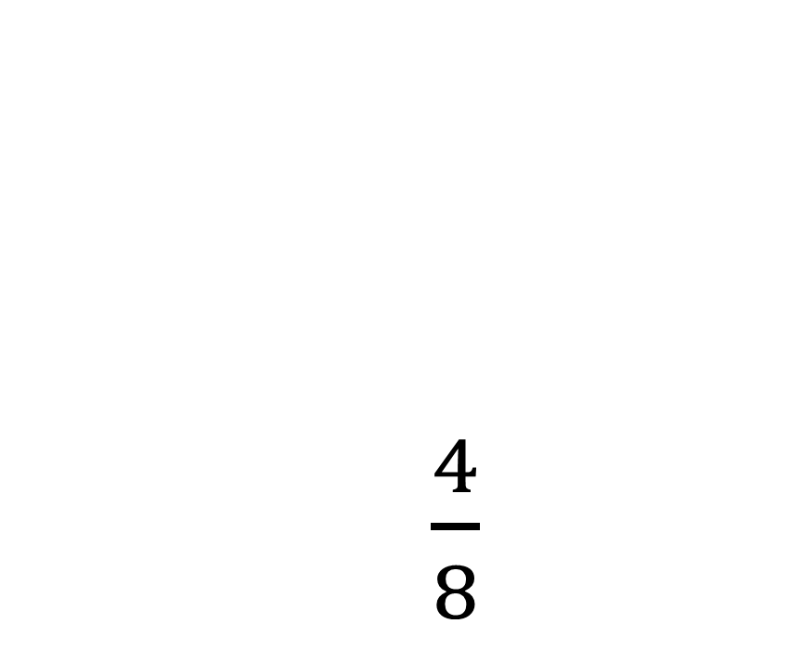
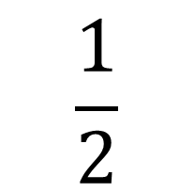
Equivalent fractions
Now, let’s look at the fractions. They don’t look the same, but pay attention to the circles.
Do the coloured parts look equal?
Yes, they are equal.
$\frac{4}{8}$
$$\frac{1}{2}$$

Slide 6

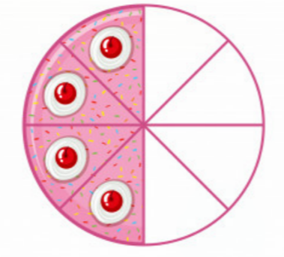
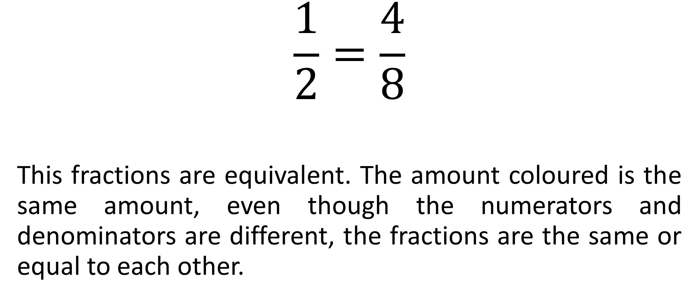
Equivalent fractions
$$\frac{1}{2}=\frac{4}{8}$$
This fractions are equivalent. The amount coloured is the same amount, even though the numerators and denominators are different, the fractions are the same or equal to each other.

