Slide 1
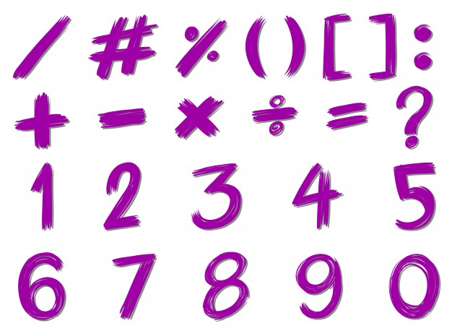
Review

Slide 2

Review
A trio is a set of numbers that make addition and subtraction families.
Let’s remember a few concepts we have learnt in the last few days.
Do you remember what a trio is?
5
2

Slide 3
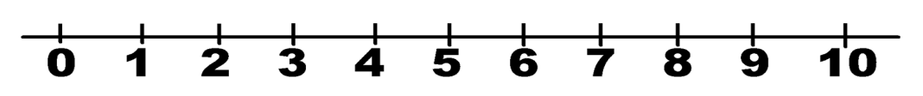

Review
Do you remember what a number line is?
It is also called number chain and it is a line of numbers that will help us add or subtract.

Slide 4


Review
Do you remember what a puzzle is?
It is a game where you have to discover or find something.

Slide 5


Review
Do you remember what a set is?
It is a group of similar things.

Slide 6

Review
It is your turn!
Go to page 63 and follow the instructions.

