Slide 1
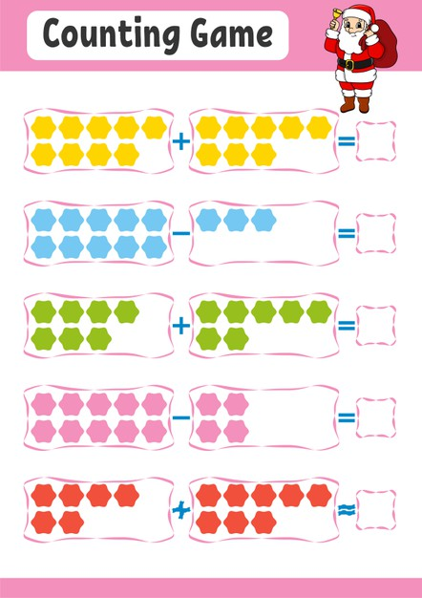
Addition & Subtraction

Slide 2
Addition
Do you remember this sign + ? Yes, this sign means add, addition or plus.
4 + 3 = 7
First look at the first number. Now you add 3 more to that first number. So, 4 add 3 equals 7.
You can use counters or a number line. Let’s use counters.
+

Slide 3

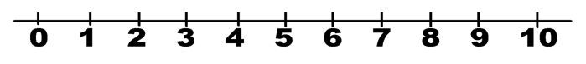
Addition
Let’s try another example.
4 + 4 = 8
Let’s use a number line now.
Well done!

Slide 4

Addition
Now let’s complete the chain number using addition.
Look!
3 + 4 = 7 7 +2 = 9 9 +3 = 12...
Can you continue?
You star the next addition with result of the last one.

Slide 5
Subtraction
Do you remember this sign -? Yes, this sign means minus, subtraction or take away.
4 - 3 = 1
First look at the first number. Now you take away 3 to that first number. So, 4 minus 3 equals 1.
You can use counters or a number line. Let’s use counters.
= 1

Slide 6
Subtraction
Let’s try another example.
8 - 6 = 2
Let’s use a number line now.
Well done!

Slide 7

Subtraction
Now let’s complete the chain number using subtraction. Look!
10 - 2 = 8 8 -2 = 6 6 -2 = 4...
Well done!

