Slide 1
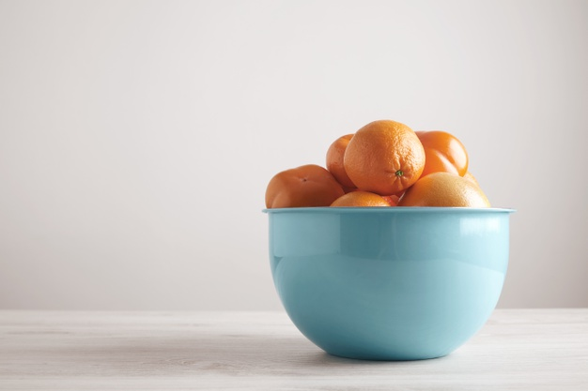
Multiplication word problems

Slide 2
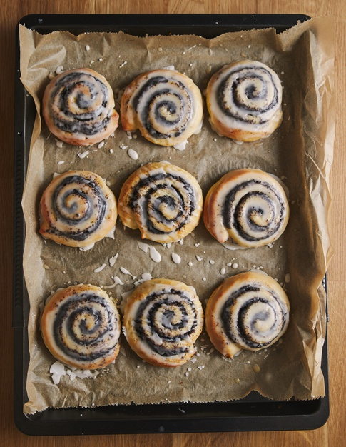
Multiplication word problems
To solve multiplication word problems we can use a few steps:
First underline the key information
Next decide on the number sentence
Multiply starting from the smallest value
Convert the result to the units you need to find.

Slide 3


Multiplication word problems
Mrs. Harper has 5 children and she wants to give 3 sweets each. How many sweets does she need in total?
Let’s read the problem again and underline the key information.

Slide 4
Multiplication word problems
Mrs. Harper has 5 children and she wants to give 3 sweet each. How many sweets does she need in total?
Now that we have the key information, let’s write a number sentence.
5 children
3 sweets
Total ? 3 x 5 =

Slide 5

Multiplication word problems
Mrs. Harper has 5 children and she wants to give 3 sweet each. How many sweets does she need in total?
You can solve the multiplication now.
3 x 5 = 15

Slide 6
Multiplication word problems
Mrs. Harper has 5 children and she wants to give 3 sweet each. How many sweets does she need in total?
Answer: Mrs. Harper needs 15 sweets in total.
3 x 5 = 15

Slide 7

Multiplication word problems
Go to page 59 and solve more multiplication word problems.

