Slide 1

Let’s talk about
activities in present simple!

Slide 2

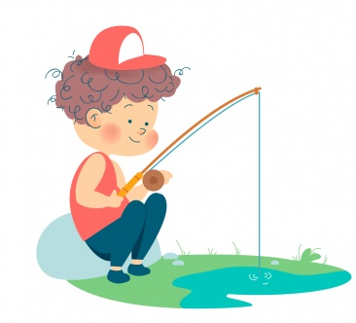
Talk about: Which activities do you like?
“I like …”
to fish
to read
to cook

Slide 3
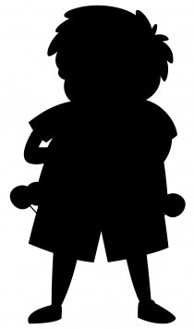
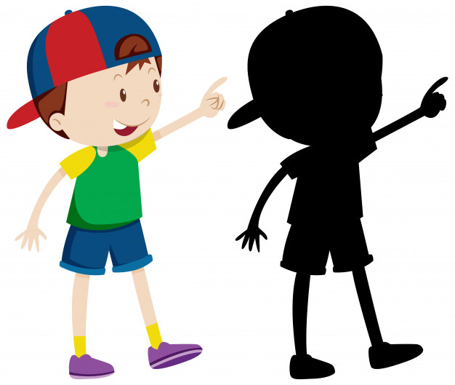

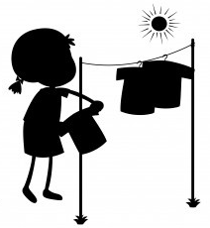

Find the shape!
Match the kids with their correct shapes.

Slide 4
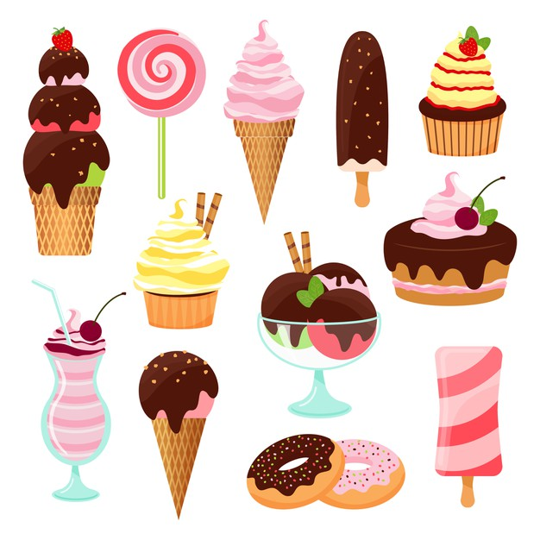
Zack’s habits.
.Complete the text with the correct form of the verb.
Hi! I’m Zack, I _______ (study) at the Valley elementary school. In the morning, I _______ (wake up) at 6 AM, I like ______ (eat) waffles as breakfast, and then I ____ (go) to school by bus.
In the afternoon, I like _______ (play) videogames with my brother and we love _____ (eat) ice-cream. What do you like to do in the afternoons?

Slide 5

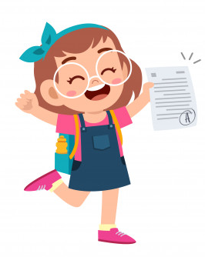
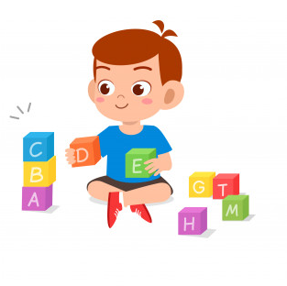
Talk about: Activities you don’t like.
“I don’t like …”
to have exams
to build with blocks
to sing

Slide 6

Circle the activities you can do in the evening.
To do karate
To sleep
To eat
breakfast
To go
to school

Slide 7


