Slide 1


Past SIMPLE
tense
I watch movies with my family every weekend.
When I was a kid, I watched movies with my family every weekend.

Slide 2
Verbs
(Regular & Irregular)
REGULAR VERBS | IRREGULAR VERBS
E.g. Wash. Washed. Washed | E.g. Run. Ran. Run
Cook. Cooked. Cooked | Sleep. Slept. Slept
Study. Studied. Studied | Drink. Drank. Drunk
Watch. Watched. Watched | Buy. Bought. Bought
Play. Played. Played | Read. Read. Read
Think about some verbs you can use
when you are talking about daily routines.

Slide 3
PAST SIMPLE tense
*Actions finished in the past.
* Series of completed actions in the past.
On regular verbs add -ed to the verb, on irregular verbs the structure changes.
I visit Berlin. I visited Berlin last week.
First, I get up, then I have breakfast. First, I got up, then I had breakfast.

Slide 4
PAST SIMPLE tense (Affirmative +)
S + V Past Simple + C
 | Present Simple | Past Simple (+) | Example in Past Simple
Regular Verb | I cook pasta in the afternoon. | I cooked pasta in the afternoon.
Irregular Verb | She wakes up at 7 o’clock and she buys a coffee. | She woke up at 7 o’clock and she bought a coffee.
EXERCISE 1a: Complete the chart with your own example.

Slide 5
PAST SIMPLE tense (negative -)
S + Auxiliary + not + V Inf + C
[did]
 | Present Simple | Past Simple (-) | Example in Past Simple
Regular Verb | I cook pasta in the afternoon. | I didn’t cook pasta in the afternoon.
Irregular Verb | She wakes up at 7 o’clock and she buys a coffee. | She didn’t wake up at 7 o’clock and she didn’t buy a coffee.
EXERCISE 1b: Complete the chart with your own example.

Slide 6
PAST SIMPLE tense (interrogative ?)
Auxiliary + S + V Inf + C ?
[Did]
 | Present Simple | Past Simple (?) | Example in Past Simple
Regular Verb | I cook pasta in the afternoon. | Did I cook pasta in the afternoon?
Irregular Verb | She wakes up at 7 o’clock and she buys a coffee. | Did she wake up at 7 o’clock and did she buy a coffee?
EXERCISE 1c: Complete the chart with your own example.

Slide 7
Present Simple Tense | Past Simple Tense
I wash the dishes with cold water. | AFFIRMATIVE (+) I washed the dishes with cold water.
She sleeps well all night long. | NEGATIVE (-) She didn’t sleep well all night long.
We study French at University. | INTERROGATIVE (?) Did we study French at University?
He drinks a lot of coffee. | NEGATIVE (-) __________________________________
You watch a lot of action movies. | INTERROGATIVE (?) ___________________________________
They run 10 km for the race. | AFFIRMATIVE (+) ___________________________________
EXERCISE 2: Change the following sentences into affirmative, negative or interrogative.

Slide 8
 | Past Simple Tense Sentences (+) (-) (?)
Affirmative | 1. I washed my clothes every 2 weeks. 2. You cooked chicken with vegetables. 3. He studied at Elementary School.
Negative | 4. We didn’t watch TV at night. 5. It didn’t play with the ball. 6. You didn’t run very fast in the race.
Interrogative | 7. Did you sleep on the airplane? 8. Did they drink a lot of coffee? 9. Did she buy a car?
EXERCISE 3: Write 9 sentences about you and your family members’ daily routines that you had in the past.

Slide 9
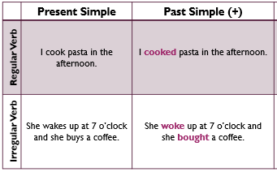
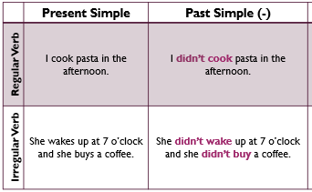
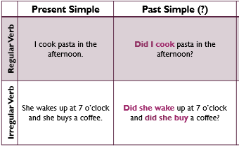
PAST SIMPLE TENSE Affirmative (+)
S + V Past Simple + C
PAST SIMPLE TENSE Negative (-)
S + Auxiliary + not + V Inf + C
[did]
PAST SIMPLE TENSE Interrogative (?)
Auxiliary + S + V Past Simple + C ?
[Did]
PAST SIMPLE TENSE

Slide 10
Thanks!

