Slide 1
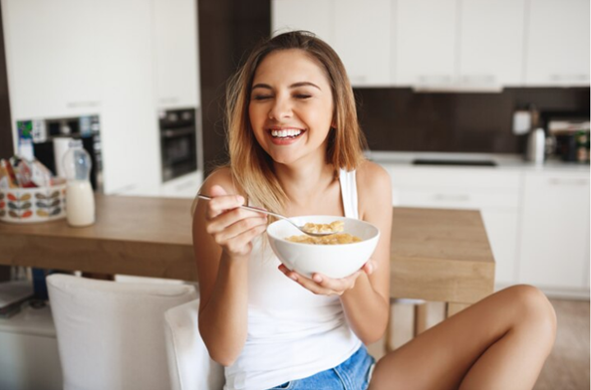

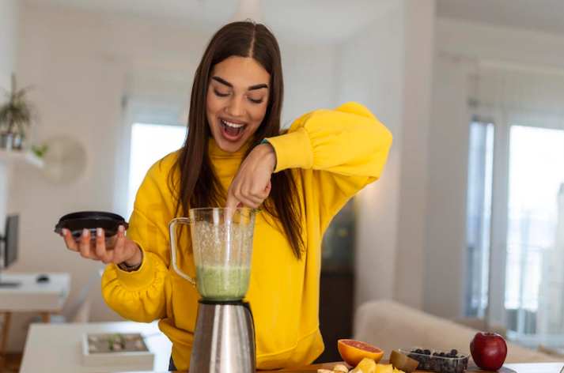
I eat porridge every morning.
Present Simple vs Present Continuous
I am using the blender to mix the cream and vegetables for the soup.

Slide 2
Verbs
(Regular & Irregular)
REGULAR VERBS | IRREGULAR VERBS
E.g. Cook. Cooked. Cooked | E.g. Cut. Cut. Cut
Boil. Boiled. Boiled | Eat. Ate. Eaten
Grill. Grilled. Grilled | Feed. Fed. Fed
Bake. Baked. Baked | Drink. Drank. Drunk
Add. Added. Added | Spread. Spread. Spread
Think about some verbs you can use when you are talking
about FOOD & FRINK.

Slide 3
Present Simple vs
Present Continuous
Differences
PRESENT SIMPLE
Repeated actions (habits, routines).
A permanent situation.
To say that something is true/untrue in general.
It is normally used to talk about THOUGHTS, FEELINGS AND STATES.
“Always” means “Every time”.
To describe main events.
For facts. E.g., Tomorrow is Tuesday.
USED FOR FUTURE
An official arrangement such as a timetable or programme.
PRESENT CONTINUOUS
Something happening at the time of speaking. The action is not finished.
A temporary situation.
To talk about changes, developments & trends.
It is mainly used for actions and happenings. It’s not usually used for states. (These verbs aren’t’ used in continuous tenses: like, love, hate, be, prefer, know, suppose, mean, believe, understand, seem, etc.).
“Always” means “Too often”.
To background events.
USED FOR FUTURE
A personal arrangement.

Slide 4


Present Simple vs
Present Continuous
Affirmative (+)
Structure | PRESENT SIMPLE [Affirmative] S + verb present form + C
E.g. | I grill some chicken for the party. She adds some sugar to her coffee. They spread some jam on their bread.
Your example
Structure | PRESENT CONTINUOUS [Affirmative] S + verb to be + verb -ing + C
E.g. | I am grilling some chicken for the party. She is adding some sugar to her coffee. They are spreading some jam on their bread.
Your example
I You He She It We You They
I You He She It We You They
am
cook
a delicious dish for me.
are
drinking
a hot chocolate.
cooks
a delicious dish for me.
is
drinking
a hot chocolate.
cook
a delicious dish for me.
are
drinking
a hot chocolate.

Slide 5
Present Simple vs
Present Continuous
Negative (-)
Structure | PRESENT SIMPLE [Negative] S + do/does not + verb simple form + C
E.g. | I don’t grill any chicken for the party. She doesn’t add any sugar to her coffee. They don’t spread any jam on their bread.
Your example
Structure | PRESENT CONTINUOUS [Negative] S + verb to be + not + verb -ing + C
E.g. | I am not grilling any chicken for the party. She isn’t adding any sugar to her coffee. They aren’t spreading any jam on their bread.
Your example
I You He She It We You They
don’t cook
I You He She It We You They
am not
a delicious dish for me.
aren’t
drinking
a hot chocolate.
doesn’t cook
a delicious dish for me.
isn’t
drinking
a hot chocolate.
don’t cook
a delicious dish for me.
aren’t
drinking
a hot chocolate.

Slide 6
Present Simple vs
Present Continuous
Interrogative (?)
Structure | PRESENT SIMPLE [Interrogative] Do/ Does + S + verb simple form + C ?
E.g. | Do I grill some chicken for the party? Does she add some sugar to her coffee? Do they spread some jam on their bread?
Your example
Structure | PRESENT CONTINUOUS [Interrogative] Verb to be + S + verb -ing + C
E.g. | Am I grilling some chicken for the party? Is she adding some sugar to her coffee? Are they spreading some jam on their bread?
Your example
I you he she it we you they
Am
I you he she it we you they
Do
cook
a delicious dish for me?
Are
drinking
a hot chocolate?
Does
cook
a delicious dish for me?
Is
drinking
a hot chocolate?
Do
cook
a delicious dish for me?
Are
drinking
a hot chocolate?

Slide 7
Present Simple
Structure | Present Simple [Affirmative] | Present Simple [Negative] | Present Simple [Interrogative]
Sentence 1
Sentence 2
Exercise 1a: Complete the chart.

Slide 8
Present Continuous
Structure | Present Continuous [Affirmative] | Present Continuous [Negative] | Present Continuous [Interrogative]
Sentence 1
Sentence 2
Exercise 1b: Complete the chart.

Slide 9
Present Simple vs
Present Continuous
 | [Affirmative] | [Negative] | [Interrogative]
Present Simple | She cooks every Saturday. 2. 3. They boil some water for coffee. | 1. 2. 3. They don’t boil some water for coffee. | 1. Does she cook every Saturday? 2. Does he add salt to the sauce? 3.
Present Continuous | 1. 2. I am baking a cake for my mom. 3. | 1. 2. 3. We aren’t grilling meat for meal. | 1. Is it cutting the rope? 2. 3.
Exercise 2: Change the following sentences into Present Simple or Present Continuous (Affirmative, Negative or Interrogative).

Slide 10
Present Simple vs
Present Continuous
My name is Pam, and I am currently living in Canada. I really enjoy the culture, weather and landscapes. Generally, it’s cold here. We usually wear thermal clothing. Also, we always drink hot beverages to stay warm. I am visiting mom and dad on Saturday morning. We are having breakfast and a meal at home. Today is Thursday, and I am baking a cake to take there. My parents love chocolate cake, so this dessert is a surprise for them. At midday, we always drink coffee or hot chocolate and spread some cinnamon on it. After that, mom feeds our dog, so it joins us for breakfast.
Exercise 3: Complete the story with the correct verb form.

Slide 11
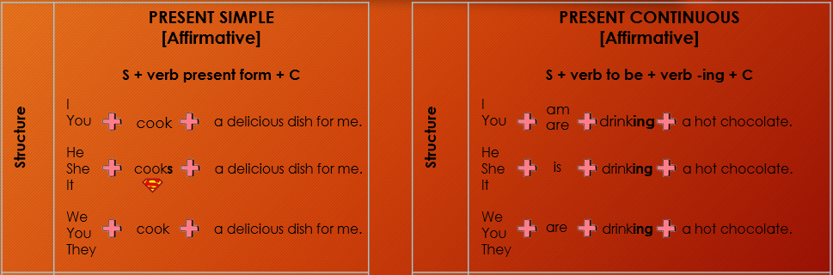
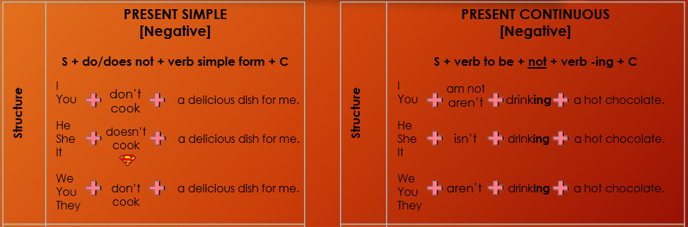
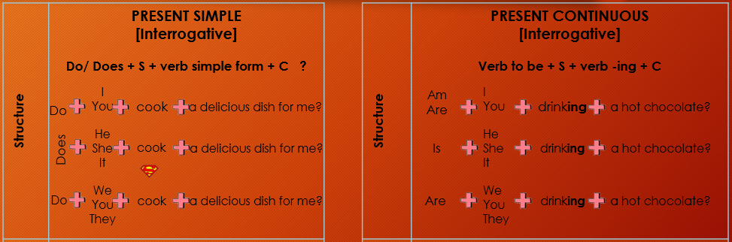
Present Simple
vs
Present Continuous
(SUMMARY)

Slide 12
Thanks!

