Slide 1
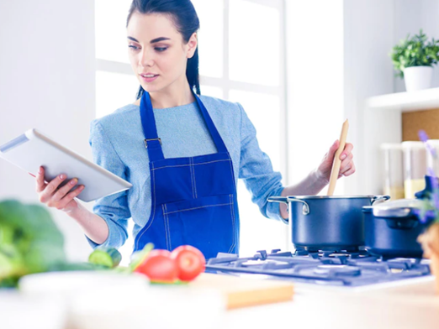

On prompt talking
LANGUAGE ADVENTURE :)

Slide 2
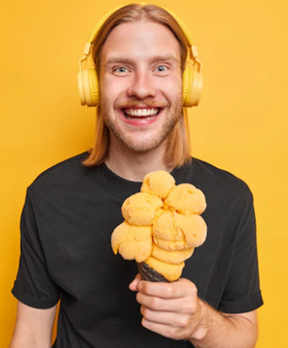
My favourite dessert is …
because …

Slide 3
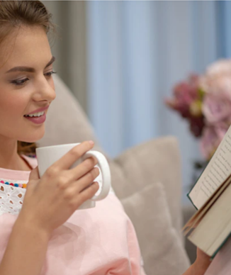
While drinking ________ on a cold day, I enjoy …

Slide 4
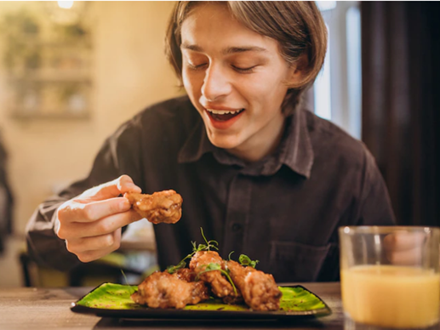
My favourite fried food is …, but I prefer ________ to be healthy.

Slide 5
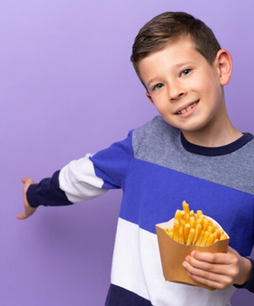
My mom just let me eat ________ once per month. I regularly eat ________ because…

Slide 6
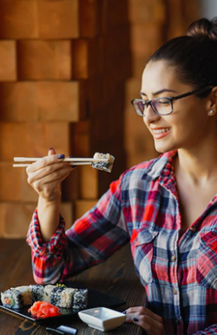
When I hang out with my friends, we usually eat ______________, we really enjoy…

Slide 7
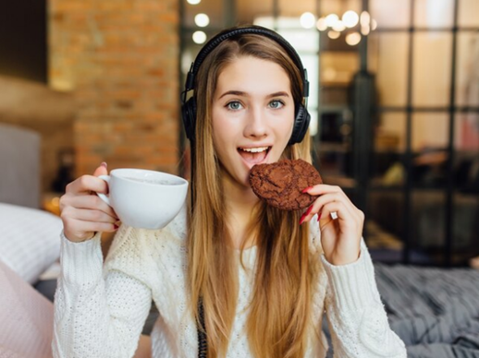
For dessert, I always order…

Slide 8
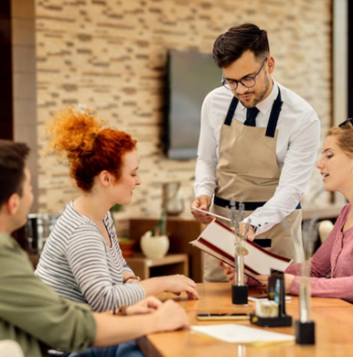
On weekends,
I go to … with my family, and we frequently eat...

Slide 9
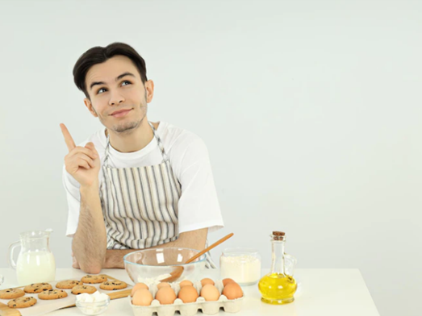
I love baking … with my sister, she is always …

Slide 10
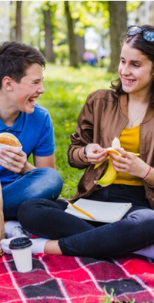
I prefer healthy food to junk food because…

Slide 11
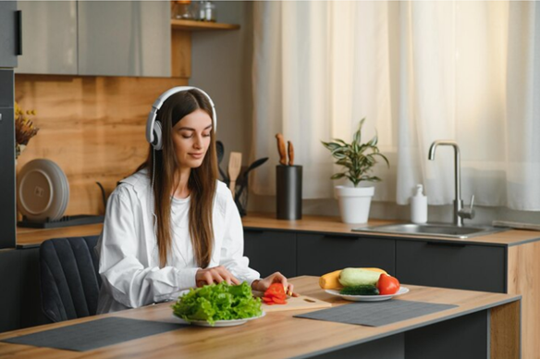
Nice on prompt talking
Thanks!

