Slide 1

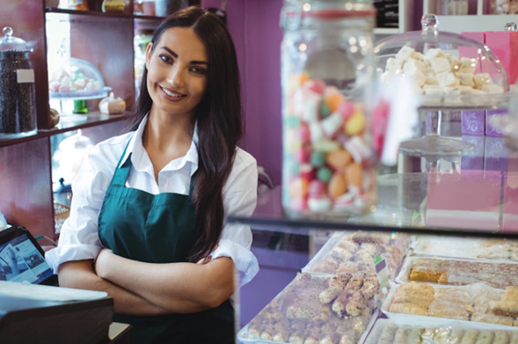
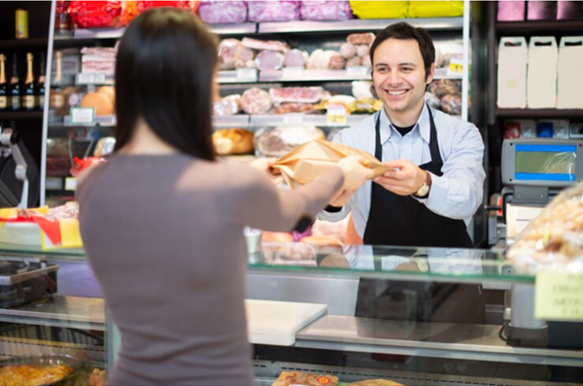

PAST continuous TeNSE
When he received the money, he was resting at home.
She was working at the candy shop while I was taking my flight.
Were they buying groceries when it started raining?

Slide 2
Verbs
(Regular & Irregular)
REGULAR VERBS | IRREGULAR VERBS
E.g. Visit. Visited. Visited | E.g. Buy. Bought. Bought
Arrive. Arrived. Arrived | Go. Went. Gone
Compare. Compared. Compared | Pay. Paid. Paid
Purchase. Purchased. Purchased | Send. Sent. Sent
Receive. Received. Received | Take. Took. Taken
Think about some verbs you can use when you are talking
about SHOPPING.

Slide 3
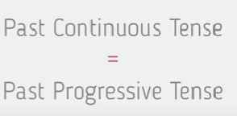
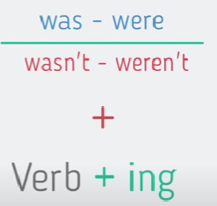
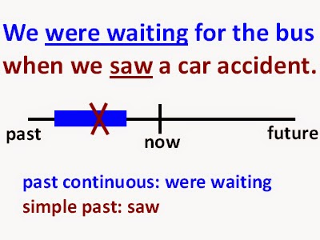
Past Continuous Tense
Description
We use the Past Continuous to talk about actions that happened in the past but went on for a period of time.

Slide 4

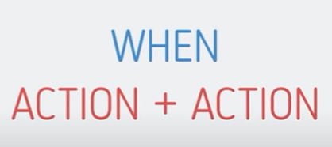
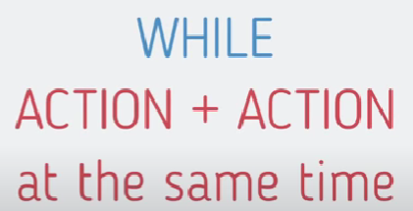
Past Continuous Tense
Description
Time Clauses : When & While
WHEN Shows what was occurring and what was happening at the moment another activity occurred. E.g. I was watching T.V. when my father came home. When you called me, I was washing the dishes. WHILE Shows that two actions were occurring at the same time. E.g. I was watching T.V. while my father was waiting in the kitchen. While I was washing some dishes, you were cleaning the hall. To talk about actions that are not related at all. E.g. While I was studying English, my sister was chatting with her friends. While I was talking on the phone, my mom was cooking.

Slide 5
Past Continuous Tense
Affirmative (+)
Negative (-)
Interrogative (?)
Exercise
1
PAST CONTINUOUS
[AFFIRMATIVE] S + was / were + verb -ing + C | [NEGATIVE] S + was / were + not + verb -ing + C | [INTERROGATIVE] Was / Were + S + verb –ing + C ?
E.g. I was reading a book when my sister called me.
1. (+) You
2. (-) She
3. (?) They
4. (-) I
Write 4 sentences in Past Continuous.
(Use WHEN & WHILE)

Slide 6
Past Continuous Tense
Exercise
2
The waiter was waiting for the order while… ___________________________________________________________________________.
When my cousins were playing Xbox, my sister… ___________________________________________________________________________.
While mum _________________________________________________________________, dad ________________________________________________________________________.
____________________________________________________________________________
___________________________________________________________________________.
Complete the sentences.

Slide 7
Past Continuous Tense
Exercise
3
1. (-)__________________________________________________________________________
___________________________________________________________________________.
2. (-)__________________________________________________________________________
___________________________________________________________________________.
3. (?)__________________________________________________________________________
___________________________________________________________________________.
4. (?)__________________________________________________________________________
___________________________________________________________________________.
From Exercise 2, change the sentences into negative and interrogative form.

Slide 8
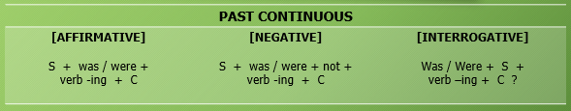
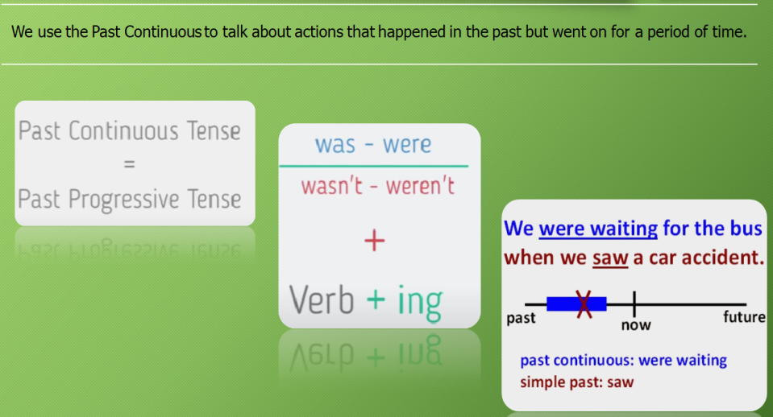
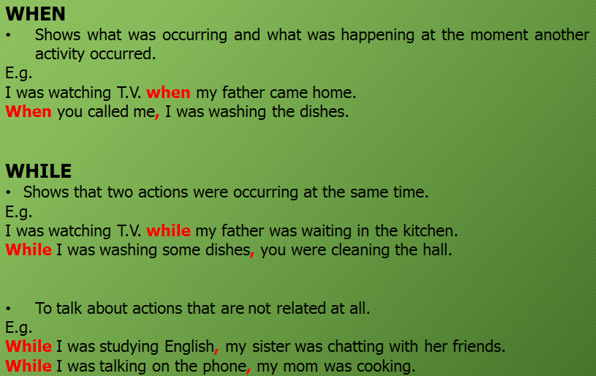
Past Continuous
Past Continuous
(SUMMARY)

Slide 9
Thanks!

