Slide 1


On prompt talking
LANGUAGE ADVENTURE :)

Slide 2

I love to travel around the world because…

Slide 3

If we hit the books, I’m sure we will _______
_______________.
hit the books = study something a lot

Slide 4

My sister is studying abroad. She got a university ________, so she isn’t paying tuition.

Slide 5

On the summer internship, I ________ lots of new friends, that was one of the most… in my life.

Slide 6
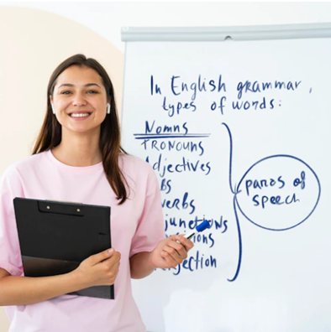
Being a language teacher is …

Slide 7

Knowing languages will help you when…

Slide 8
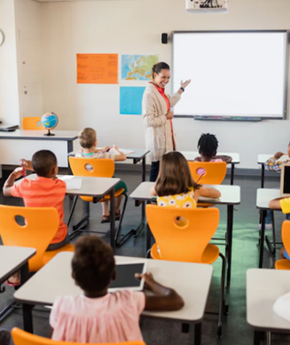
Studying with more people is better because you can…

Slide 9

Since I started learning English, I could ________ around the world.

Slide 10
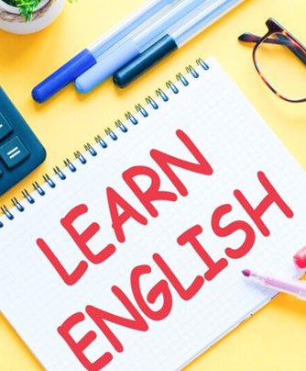
The best thing about studying abroad is…

Slide 11


You did a great prompt talking!
Thanks!

