Slide 1

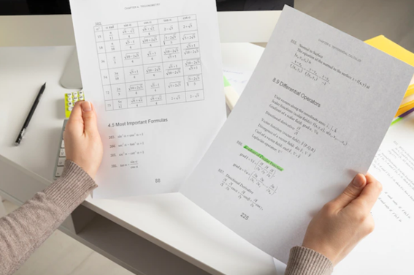
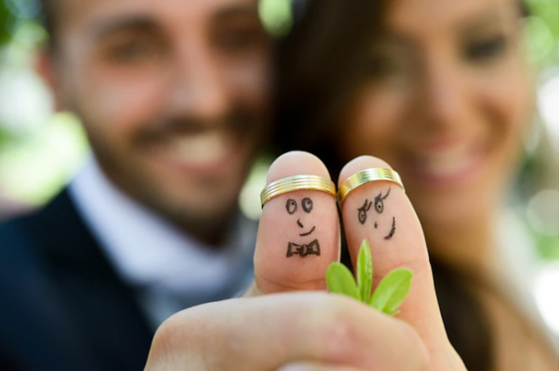

Present perfect simple
I have travelled around the world.
They haven’t finished the exam yet.
Have you got married?

Slide 2
Verbs
(Regular & Irregular)
REGULAR VERBS | IRREGULAR VERBS
E.g. Believe – believed - believed | E.g. Feel – felt - felt
Agree – agreed - agreed | Think – thought - thought
Appreciate – appreciated - appreciated | Know – knew - known
Doubt – doubted – doubted | Hear – heard - heard
Imagine – imagined - imagined | See – saw - seen
Think about some verbs you can use when you are talking
about feelings.

Slide 3
Present Perfect Simple
This is how we must use Present Perfect Simple:
PRESENT PERFECT SIMPLE
AFFIRMATIVE (+) S + have/has + verb past participle + C | NEGATIVE (-) S + have/has + not + verb past part + C have not = haven’t has not = hasn’t | INTERROGATIVE (?) Have/Has+ S + verb past part + C ?

Slide 4
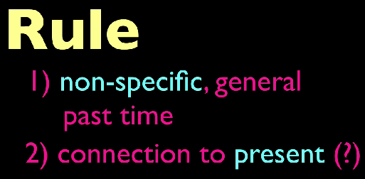
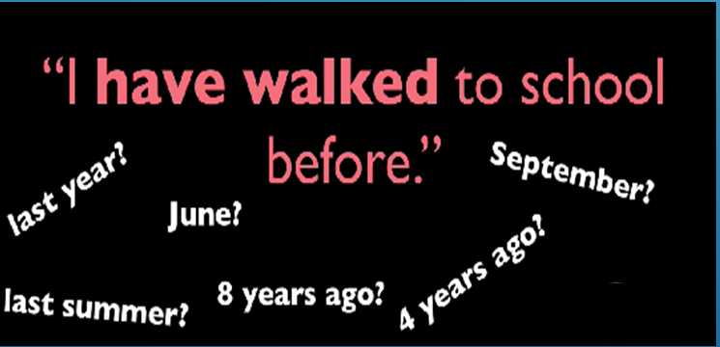
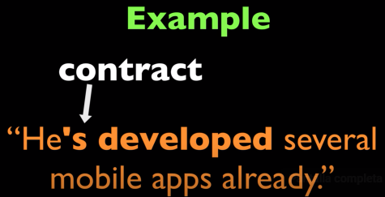
Present Perfect Simple
We can use the Present Perfect Simple in the following cases:
To talk about things that happened in the past, but the listener doesn’t know exactly when the action was.

Slide 5
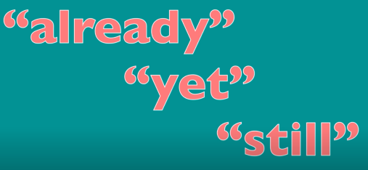



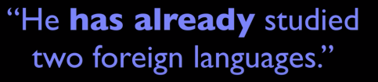
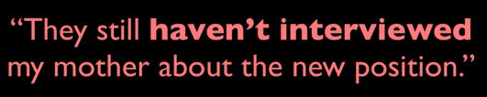

Present Perfect Simple
We can use the Present Perfect Simple with:

Slide 6
Exercise 1
Choose the correct answer.
Which sentence is correct? I’ve saw that series before. I’ve see that series before. I’ve seen that series before. | B) Harry _____ studied here for long. not haven’t ‘s not | C) Which question is correct? What you have done with my book? Where has Millie put my purse? Who they’ve written to?
Which sentence is not correct? He has gone to the school last week. She has played basketball for many years. Those children have been to France twice. | B) Complete the question. Have you seen Mel __________? yesterday last week today | C) Complete the sentence (not/finish) I haven’t finished my homework yet.

Slide 7
Exercise 2: From exercise 1, change the correct sentences as prompted.
Negative | B) Affirmative | C) Affirmative
Interrogative (Change the 2 correct sentences) | B) Negative | C) Interrogative

Slide 8
Exercise 3: Create 5 sentences using Present Perfect Simple
___ ________ ________ _______________________________________________.
___ ________ ________ _______________________________________________.
___ ________ ________ _______________________________________________.
___ ________ ________ _______________________________________________.
___ ________ ________ _______________________________________________.

Slide 9
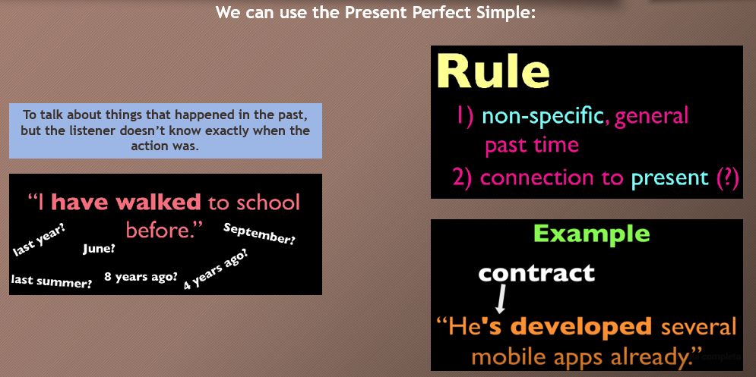
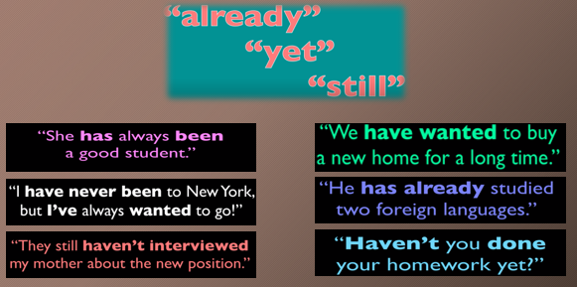
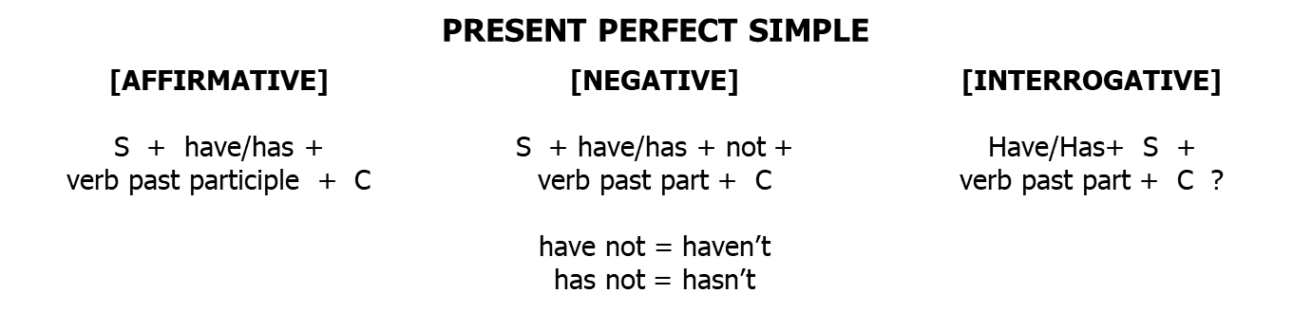
Present Perfect Simple Summary
We can use the Present Perfect Simple:
We can use the Present Perfect Simple with:

Slide 10
Thanks!

