Slide 1
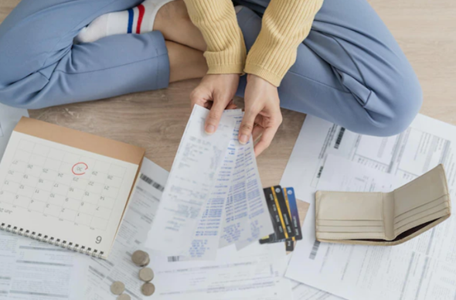
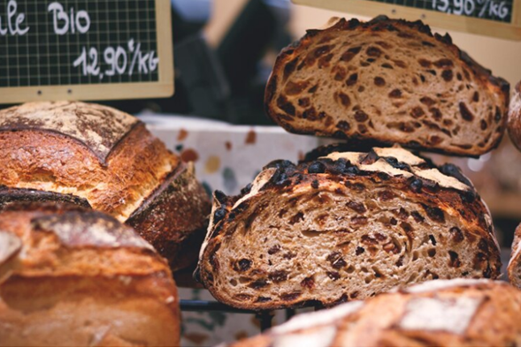


Can & could
* If you had the money, you could pay your bills.
*I can buy my books.
* I couldn’t go to the beach yesterday.
*I’m on a diet, I can’t eat bread.
* Could she read the contract?
* Can you play with us?

Slide 2
Verbs
(Regular & Irregular)
REGULAR VERBS | IRREGULAR VERBS
E.g. Purchase. Purchased. Purchased | E.g. Buy. Bought. Bought
Stay. Stayed. Stayed | Take. Took. Taken
Talk. Talked. Talked | Pay. Paid. Paid
Satisfy. Satisfied. Satisfied | Find. Found. Found
Enjoy. Enjoyed. Enjoyed | Give. Gave. Given
Think about some verbs you can use when you are talking
about shopping.

Slide 3
Can & Could
Affirmative (+)
Negative (-)
Interrogative (?)
Description
Can | Could
To describe ability. Use in present. E.g. I can play basketball. E.g. She can’t study French. E.g. Can he listen to the radio? | To describe ability or request / possibility / conditional Use in past. E.g. We could run fast. E.g. He couldn’t ride a bike. E.g. Could they pay the check? No, they can’t. (Request) E.g. Could she dance when she was a kid? No, she couldn’t. (ability)
Can
[AFFIRMATIVE] S + can + verb infinitive + C | [NEGATIVE] S + can’t + verb infinitive + C | [INTERROGATIVE] Can + S + verb infinitive + C ?
Could
[AFFIRMATIVE] S + could + verb infinitive + C | [NEGATIVE] S + couldn’t + verb infinitive + C | [INTERROGATIVE] Could + S + verb infinitive + C ?

Slide 4
Find the mistakes and cross them out
Exercise
1
Choose the correct answer
She can speak Spanish. / She can speaks Spanish. Could I use your bathroom please? Yes, could. / Could I use your bathroom please? Yes, you can. Can you help her please? / Can you helps her please? They can’t go to the trip. / They couldn’t went to the trip. He could goes to the new restaurant. / He couldn’t go to the new restaurant.

Slide 5
Write three sentences.
Exercise
2
CAN 1. _____________________________________________________________ 2. _____________________________________________________________ 3. _____________________________________________________________ COULD 1. _____________________________________________________________ 2. _____________________________________________________________ 3. _____________________________________________________________

Slide 6
From exercise 1, change the correct sentences into their opposite form.
Exercise
3
1. __________________________________________________________________. 2. __________________________________________________________________. 3. __________________________________________________________________. 4. __________________________________________________________________. 5. __________________________________________________________________.

Slide 7
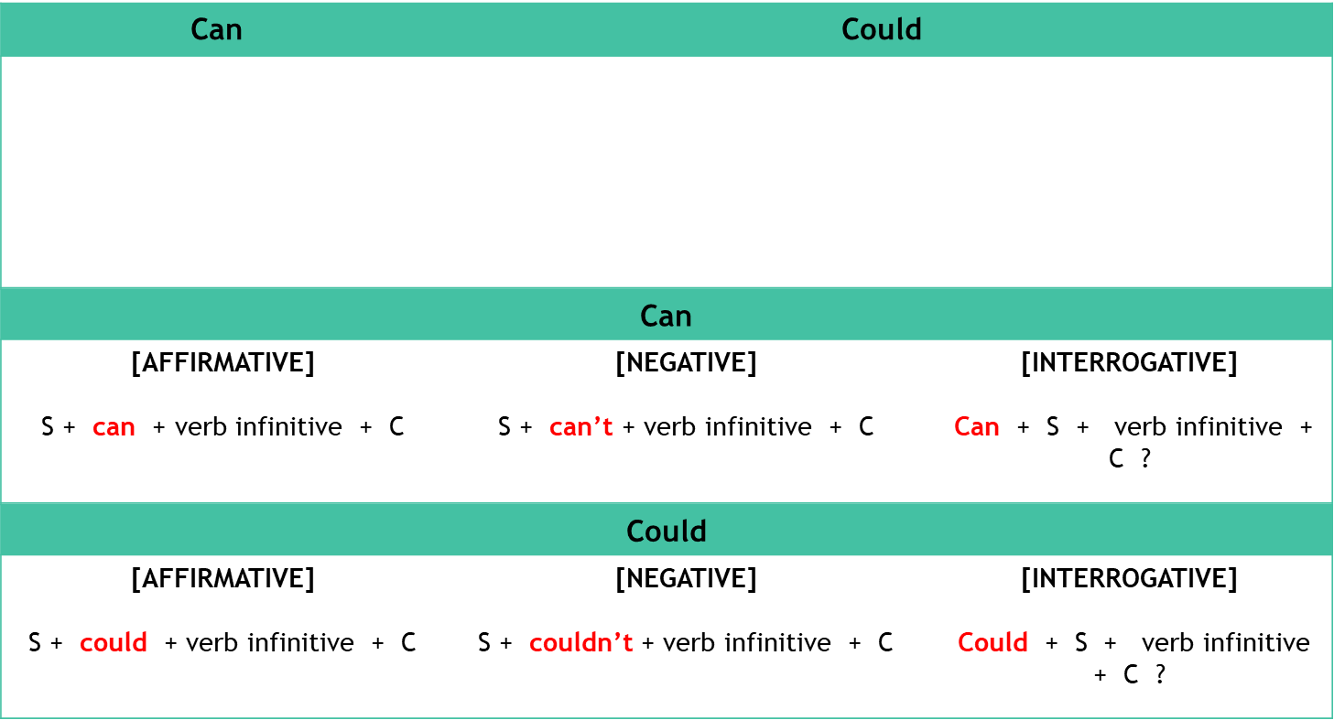
Can & Could: Summary

Slide 8
Thanks!

