Slide 1
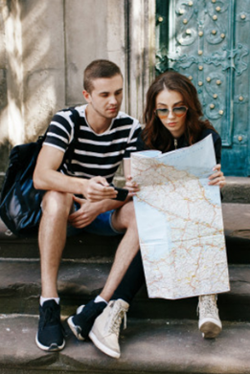

On prompt talking
LANGUAGE ADVENTURE :)

Slide 2
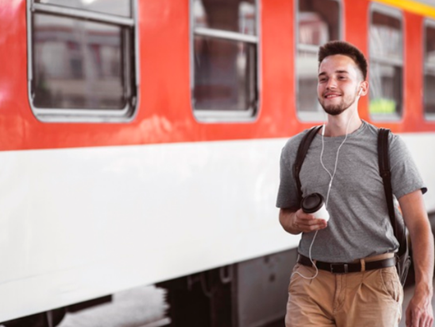
What would you do if you had to travel by subway in a different country?

Slide 3
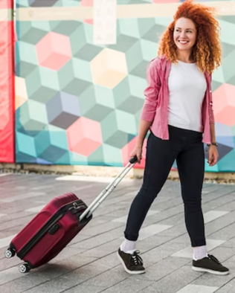
What has been your best trip?

Slide 4
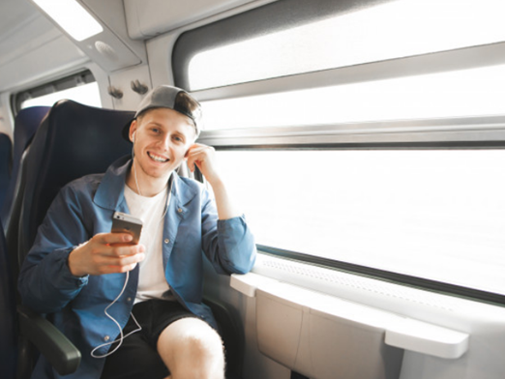
Listening to music while travelling makes me feel…

Slide 5
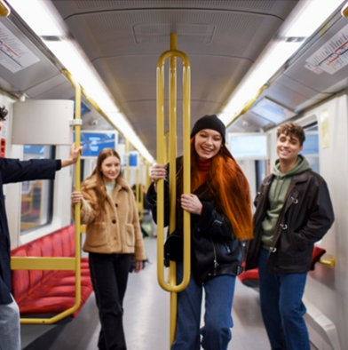
If you travel by subway in Germany, don’t forget to stamp your ________ before you start your trip.

Slide 6
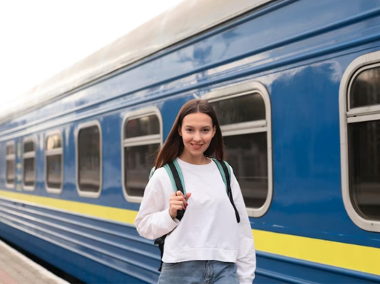
Who do you prefer travelling with?

Slide 7
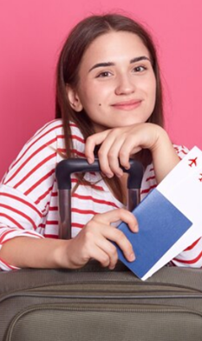
I love travelling because…

Slide 8
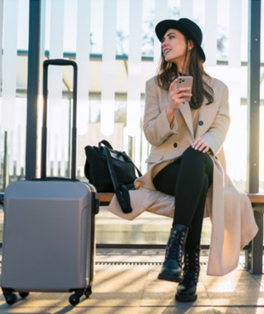
In America, the common word is “suitcase”, while the usual British word is
“l _ _ _ a _ _”.

Slide 9
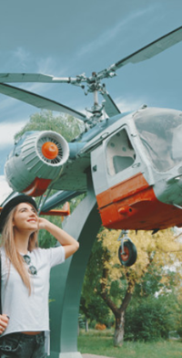
Would you prefer to travel by plane, helicopter or ship? Why?

Slide 10
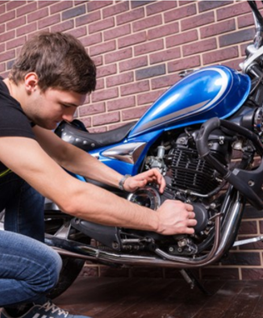
Some advantages of travelling by motorbike are…

Slide 11
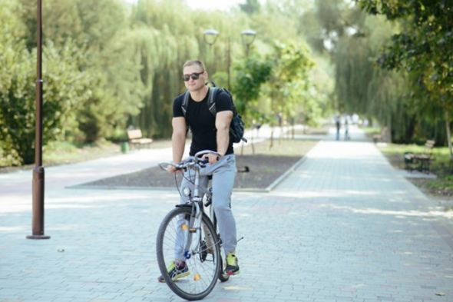

Nice on prompt talking
Thanks!

