Slide 1


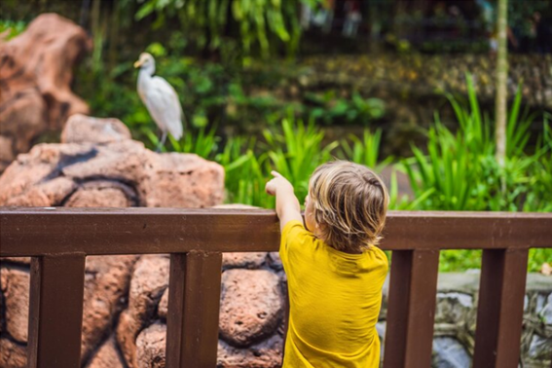

Present perfect simple
I have just spent all my money.
They haven’t asked for the check yet.
Has he gone more than once to the zoo?

Slide 2
Verbs
(Regular & Irregular)
REGULAR VERBS | IRREGULAR VERBS
E.g. Walk. Walked. Walked | E.g. Drive. Drove. Driven
Live. Lived. Lived | Fly. Flew. Flown
Experience. Experienced. Experienced | Fall. Fell. Fallen
Jump. Jumped. Jumped | Run. Ran. Run
Listen. Listened. Listened | Buy. Bought. Bought
Think about some verbs you can use when you are talking
about PLACES.

Slide 3
Present Perfect Simple
Description
1. An action, situation or event that happened in the past but continues in the present
E.g.: I have painted my face.
2. An action, situation or event that stopped recently
E.g.: I have cleaned my nose.
3. To emphasize on the result
E.g.: I have learnt 5 languages.
4. An action, situation or event has taken place once, never, or several times
E.g.: I have never been to Asia.
PRESENT PERFECT SIMPLE
[AFFIRMATIVE] S + have/has + verb past participle + C | [NEGATIVE] S + have/has + not + verb past part + C have not = haven’t has not = hasn’t
[INTERROGATIVE] Have/Has+ S + verb past part + C ?
PRESENT PERFECT SIMPLE (Short answers)
[AFFIRMATIVE] Yes, + S + have/has | [NEGATIVE] No, + S + have/has + not
have not = haven’t has not = hasn’t

Slide 4
Present Perfect Simple
Exercise
1
Which sentence is correct? I’ve bough that car before. I’ve buy that car before. I’ve bought that car before. | B) She _____ studied here. not haven’t ‘s not | C) Which question is correct? Why he has copied in the exam? Why has he copied in the exam? Why have he copied in the exam?
Which sentence is not correct? They has played videogames in their house. She has cooked pasta for the party. That kid has been to Brazil twice. | B) Complete the question. Have they seen Ger __________? last month last week today | C) Complete the sentence (not/finish) We haven’t answered the e-mail yet.
Choose the correct answer.

Slide 5
Present Perfect Simple
Exercise
2
Negative | B) Affirmative | C) Affirmative
Interrogative (Change the 2 correct sentences) | B) Negative | C) Interrogative
From exercise 1, change the correct sentences into affirmative, negative or interrogative form.

Slide 6
Present Perfect Simple
Exercise
3
According to the information presented, create 5 sentences using Present Prefect Simple.

Slide 7
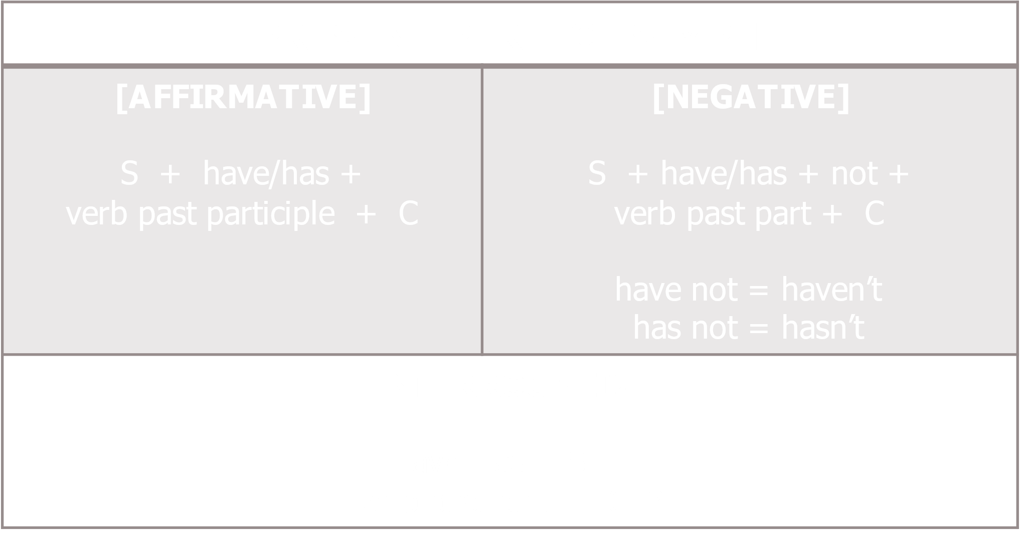
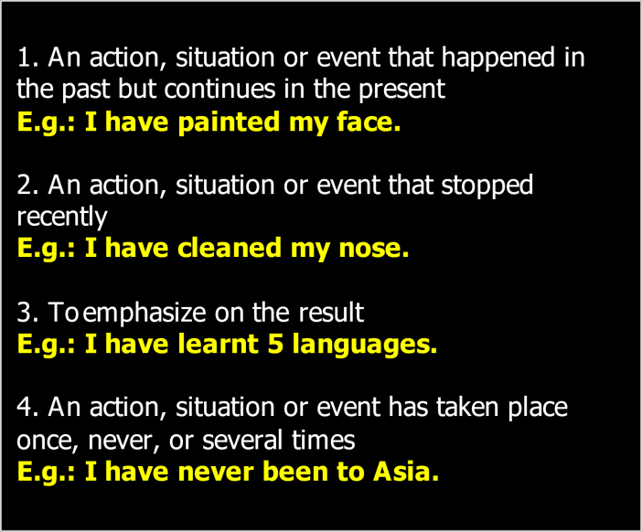
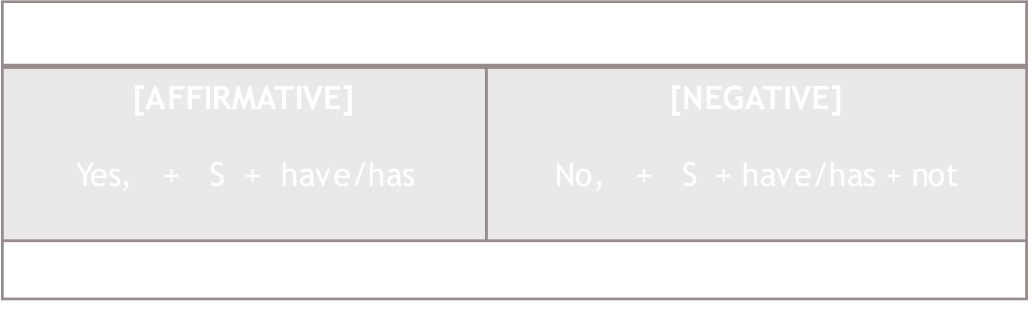
Present Perfect Simple
Present Perfect Simple
(SUMMARY)

Slide 8
Thanks!

