Slide 1
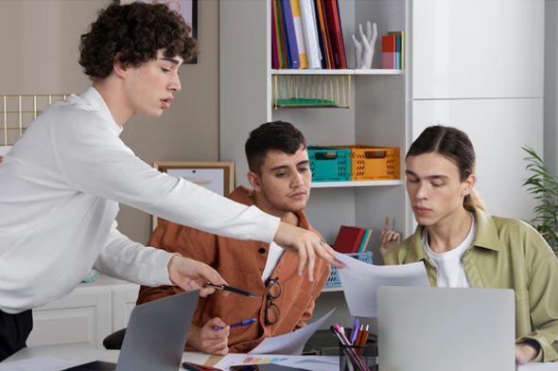

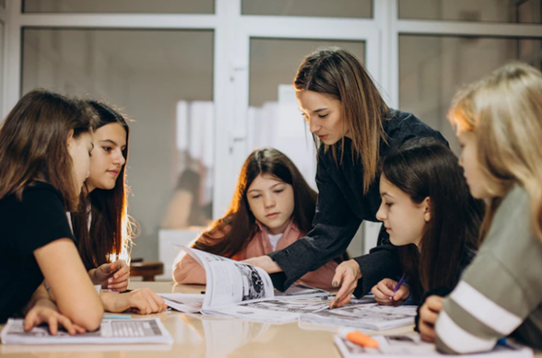

Conditionals
(Zero, first, second & third)
* If you heat milk,
it boils.
* If it snows, you will cancel the party.
* If I won the price, I would get lifted.
* If you had practiced, you would have played the piano well.

Slide 2
Verbs
(Regular & Irregular)
REGULAR VERBS | IRREGULAR VERBS
E.g. Start. Started. Started | E.g. Become. Became. Become
Talk. Talked. Talked | Bet. Bet. Bet
Travel. Travelled. Travelled | Hold. Held. Held.
Move. Moved. Moved | Lose. Lost. Lost
Create. Created. Created | Keep. Kept. Kept
Think about some verbs you can use when you are talking
about LANGUAGE.

Slide 3
Zero Conditional
Affirmative (+)
Negative
(-)
Interrogative (?)
Facts which are generally true or scientific facts.
The condition always has the same result.
Zero Conditional
[AFFIRMATIVE] If + S + present simple , + C + S + present simple + C E.g. If I put water on the stove, it boils. | [NEGATIVE] If + S + present simple , + S + does / do + not + verb infinitive + C If + S + does / do + not , + S + does / do + not + verb infinitive + C E.g. If I don’t put the ice in the freezer, it doesn’t freeze. | [INTERROGATIVE] If + S + present simple , Do / Does + S + verb infinitive + C ? If I don’t bring my umbrella, do I get wet?
NOTE: When the sentence starts with IF, use comma to separate the 2 ideas, when IF is in the middle of the sentence, you don’t use a comma.
E.g. If I leave chocolate in the sun, it melts. / Chocolate melts if I leave it in the sun.
WHEN = IF If = maybe When = I will do it!

Slide 4
1st Conditional
Affirmative (+)
Negative
(-)
Interrogative (?)
A possible situation in the future.
Predicting a likely result in the future (if the condition happen).
1st Conditional
[AFFIRMATIVE] If + S + present simple , + C + S + will + verb in infinitive + C E.g. If I go to Paris, I will visit The Eiffel Tower. | [NEGATIVE] If + S + present simple , + S + will + not + verb infinitive + C If + S + does / do + not , + S + will + not + verb infinitive + C E.g. If I don’t have money, I will not go to the movies. | [INTERROGATIVE] If + S + present simple , will + S + verb infinitive + C ? If I pay attention to my teacher, will I pass the course?
NOTE: When the sentence starts with IF, use comma to separate the 2 ideas, when IF is in the middle of the sentence, you don’t use a comma.
E.g. If I go to Paris, I will visit The Eiffel Tower. / I will visit The Eiffel Tower if I go to Paris.
WHEN = IF If = maybe When = I will do it!

Slide 5
2nd Conditional
Affirmative (+)
Negative
(-)
Interrogative (?)
Hypothetical or unlikely situations, things that are very likely to happen, like having superpowers. Unreal or impossible situation now or in the future.
2nd Conditional
[AFFIRMATIVE] If + S + past simple , + C + S + would/could + verb infinitive + C E.g. If my dog could make a wish, it would be to have 20 treats a day. | [NEGATIVE] If + S + past simple , + S + would/could + not + verb infinitive + C If + S + didn’t + verb infinitive, + S + would/could + not + verb infinitive + C E.g. If I didn’t go to the beach, I would save money for my next vacation. | [INTERROGATIVE] If + S + past simple , would + S + verb infinitive + C ? What would you buy if you won the lottery?
NOTE: When the sentence starts with IF, use comma to separate the 2 ideas, when IF is in the middle of the sentence, you don’t use a comma.
E.g. If I went to Paris, I would visit The Eiffel Tower. / I would visit The Eiffel Tower if I went to Paris.
WHEN = IF If = maybe When = I will do it!

Slide 6
3rd Conditional
Affirmative (+)
Negative
(-)
Interrogative (?)
The person is imagining a different past.
Imaginary situation that didn’t happen in the past.
3rd Conditional
[AFFIRMATIVE] If + S + past perfect , + C + S + would/could + have + past participle+ C E.g. If you had studied hard, you would have won the scholarship. | [NEGATIVE] If + S + past perfect , + S + would/could + have + verb past participle + C If + S + hadn’t + past participle, + S + would/could + have + past participle+ C E.g. If she hadn’t been sick, she would have travelled abroad. | [INTERROGATIVE] If + S + past perfect , would + S + have + verb past participle + C ? What would he have bought if he had earned millions of dollars?
NOTE: When the sentence starts with IF, use comma to separate the 2 ideas, when IF is in the middle of the sentence, you don’t use a comma.
E.g. If I had studied, I would have won the scholarship. / I would have won the scholarship if I had studied.
WHEN = IF If = maybe When = I will do it!

Slide 7
Conditionals
(Zero, First, Second & Third)
Exercise
1
Sentences
____________________________________________________________________________________. ____________________________________________________________________________________. ____________________________________________________________________________________. ____________________________________________________________________________________. ____________________________________________________________________________________. ____________________________________________________________________________________. ____________________________________________________________________________________. ____________________________________________________________________________________.
Write 8 sentences (2 sentences per Conditional).

Slide 8
Conditionals
(Zero, First, Second & Third)
Exercise
2
_____________________________________________________________________________________________________________________________________________________________________________________________ _____________________________________________________________________________________________________________________________________________________________________________________________
Write a 6 line-paragraph using 0 and 1st Conditional. Topic: Language

Slide 9
Conditionals
(Zero, First, Second & Third)
Exercise
3
_____________________________________________________________________________________________________________________________________________________________________________________________ _____________________________________________________________________________________________________________________________________________________________________________________________ _______________________________________________________________
Write a story using 2nd and 3rd conditional, underline the tenses of the conditionals.

Slide 10
Thanks!

