Slide 1
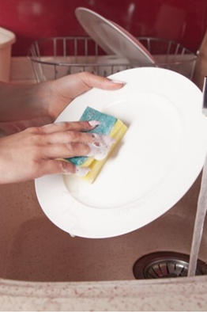

On prompt talking
LANGUAGE ADVENTURE :)

Slide 2
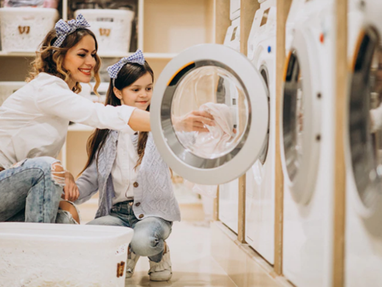
Wash clothes or ________ ________ mean the same.

Slide 3
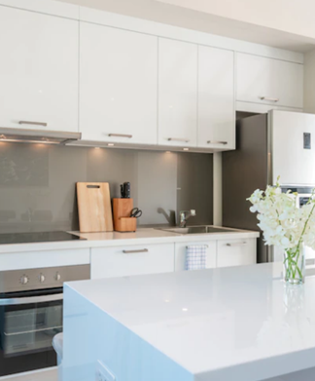
In my kitchen, I keep the ________ in the cabinets and ________ in the pantry.

Slide 4
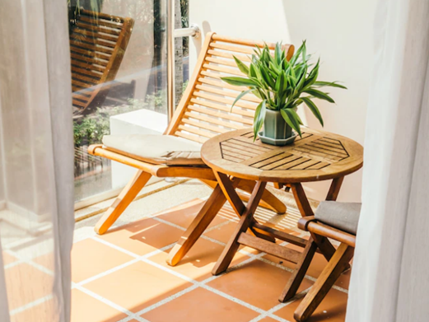
What’s the difference between a terrace and a balcony?

Slide 5
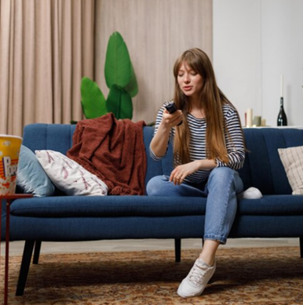
I enjoy being at home because…

Slide 6
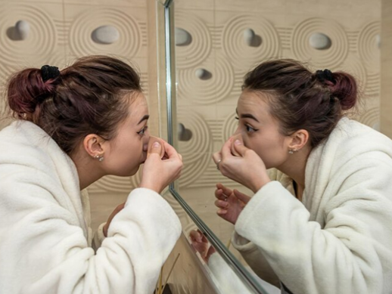
My sister/brother spends so much time in the bathroom – that gets me feel ________ because…

Slide 7
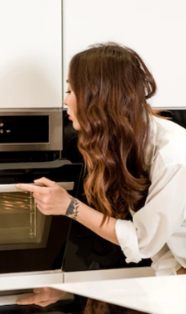
What’s the safest place in a house?
Why?

Slide 8
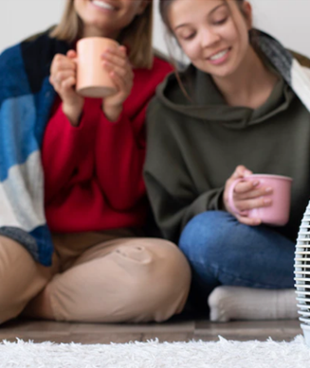
My family and I share time at home in the ________ - that’s our favourite place because…

Slide 9
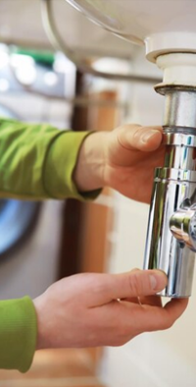
Who fixes things in your house?

Slide 10
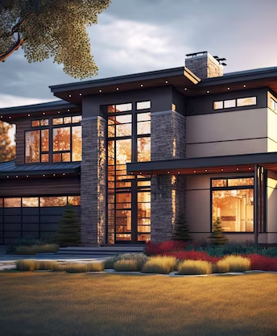
What’s the difference between house and home?

Slide 11
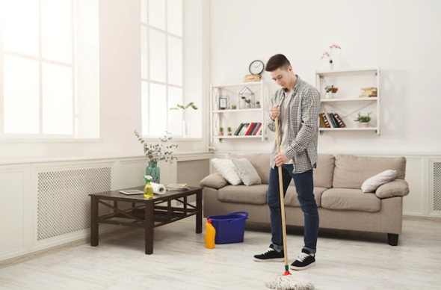

Nice on prompt talking
Thanks!

