Slide 1
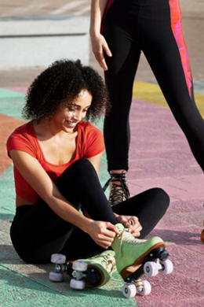

On prompt talking
LANGUAGE ADVENTURE :)

Slide 2
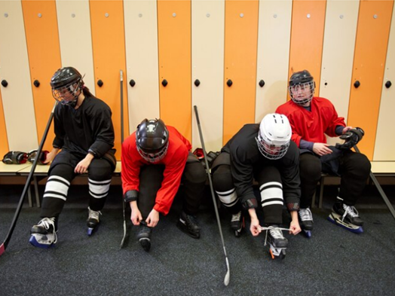
Skating is one of the
________ sports.

Slide 3
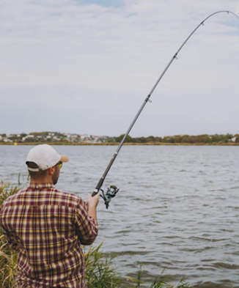
Have you _____ tried fishing?
Is it fun?

Slide 4
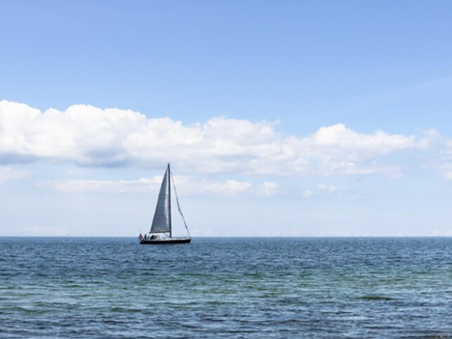
My favourite sport is… because…

Slide 5
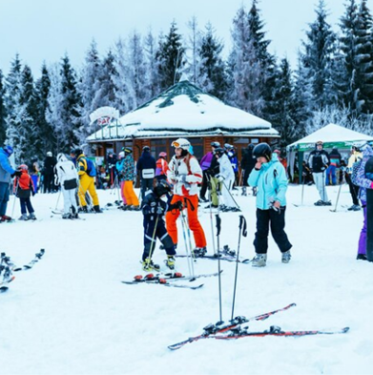
In which country is skiing the _____ popular sport?

Slide 6
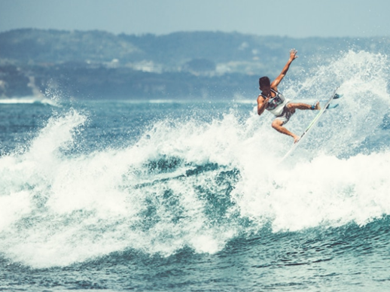
I like aquatic sports because…

Slide 7
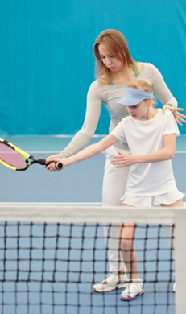
To become a sportsperson, you have to follow some rules like: __________________________________________.

Slide 8
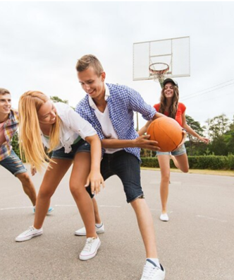
I used to play basketball at school. That was…

Slide 9
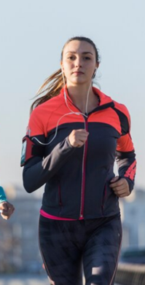
Running is one of the most ______ activities. I enjoy it a lot - I run every…

Slide 10
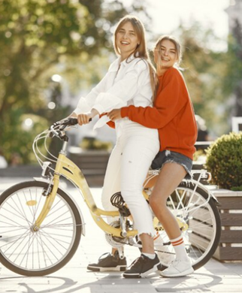
Riding a bike with my mom is…

Slide 11
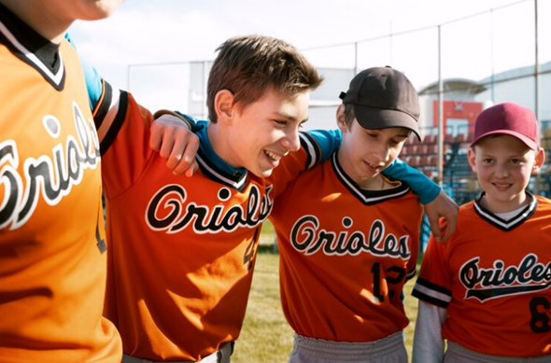

Nice on prompt talking
Thanks!

