Slide 1
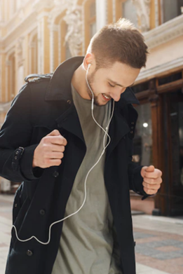

On prompt talking
LANGUAGE ADVENTURE :)

Slide 2
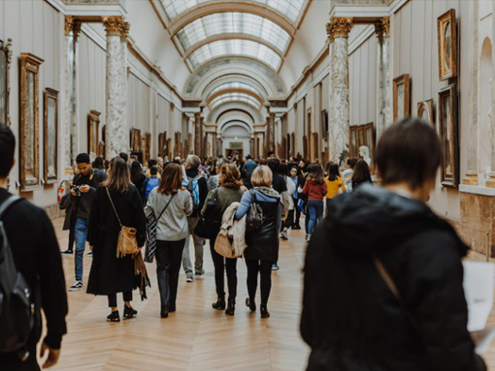
Is visiting museums a good hobby? Explain.

Slide 3
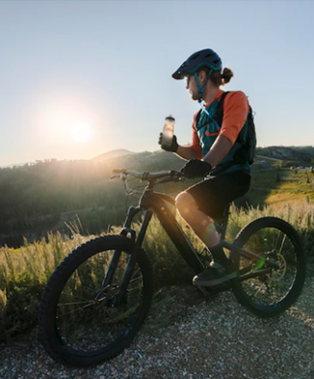
Riding my bike on weekends makes me feel… because…

Slide 4
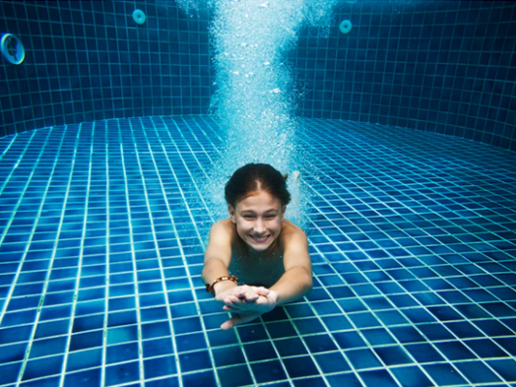
________ is my favourite hobby because…

Slide 5
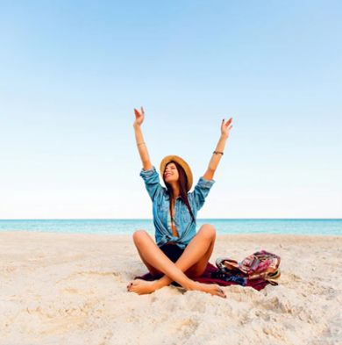
Going to the beach is a good experience. You can always…

Slide 6
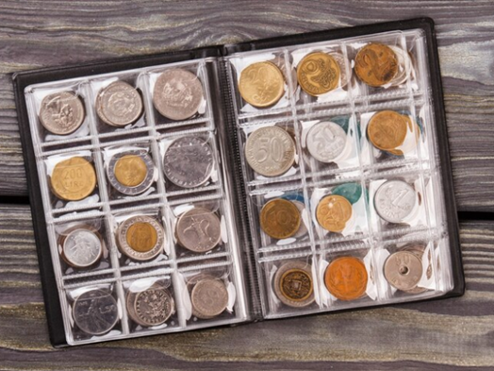
Collecting objects is…

Slide 7
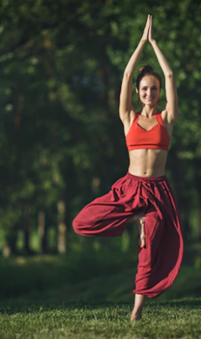
Doing exercise with more people helps you to…

Slide 8
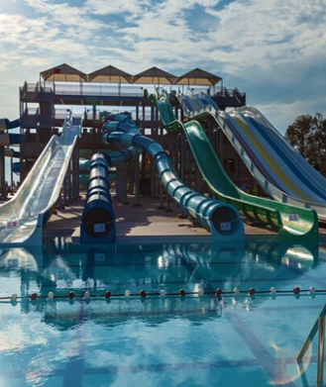
Some people think that slides in water parks are ...
In my opinion, that is…

Slide 9
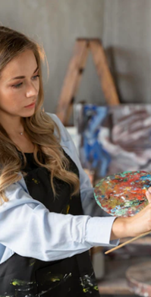
Having a favourite hobby is good because…

Slide 10
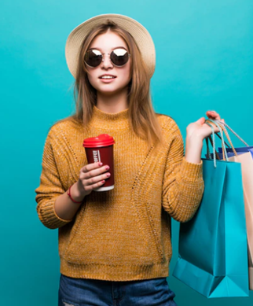
Going shopping is one of the best feelings one can experience.
I can´t…

Slide 11
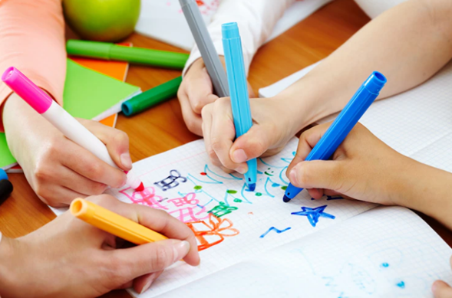

Nice on prompt talking
Thanks!

